Slide 1
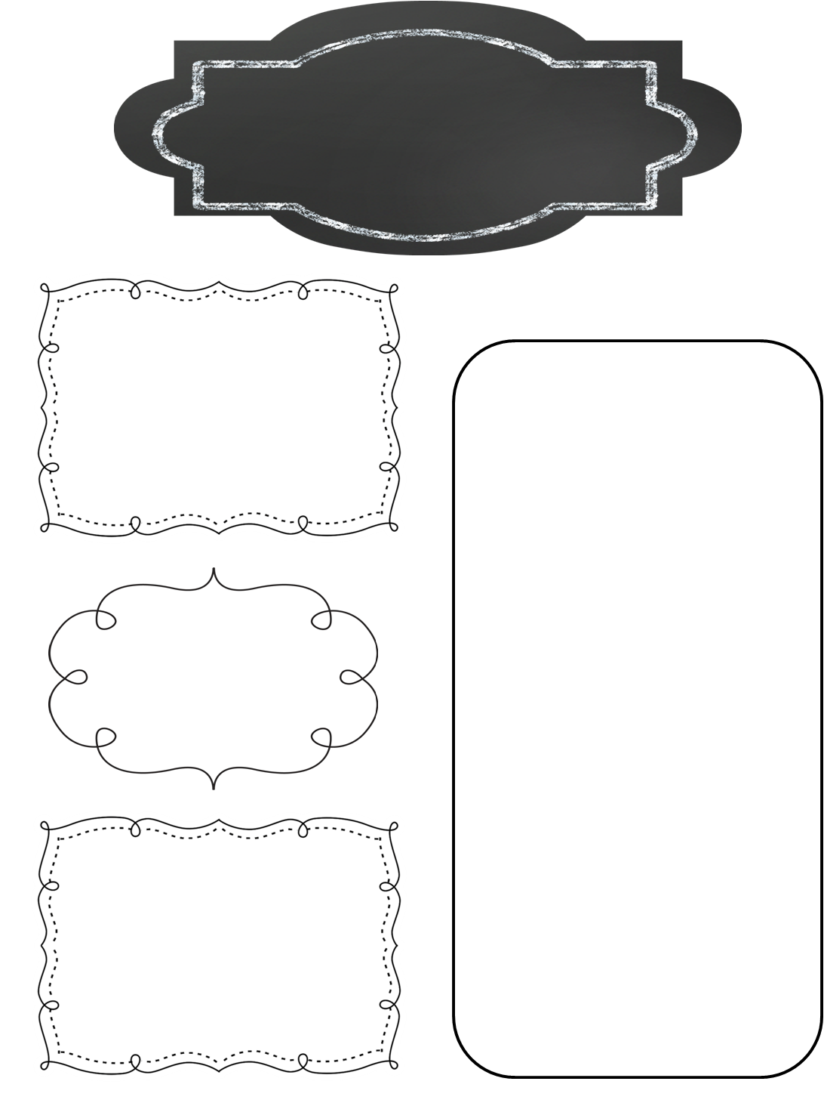
A Peek at This Week in…
Mrs. McFarland’s Class
Week of February 3rd
Reminders
We have switched to a 7 day schedule for our reading units. This is in an effort to get in more daily writing. Please consult the online assignment page, your child’s agenda, or this weekly newsletter for information on reading/language/spelling test days. Tests days may not be Fridays.
Math (McFarland)
Patterns and Graphing Ordered Pairs on a Coordinate Plane
Test Wednesday
Reading (McFarland)
Unit 3, L#12 (See the attached skills & strategies sheets for the unit.)
Tests next Wednesday!!
Students should make their own containers for their Valentines. We will not have a full blown party—students will pass out Valentines and then watch National Treasure in the afternoon. The student list is attached.
Spelling (McFarland)
VCCV pattern
Test next Wednesday
Language Arts/Writing (McFarland)
Upcoming Events
Verb Tenses
Daily Proofreading
Problem-Solution Essay
Monday, February 3-Friday, February 7: Star Lab
Wednesday, February 12th: Spring Pictures
Friday, February 14th: Manners Meal, Hall of Presidents (8:30-10:30), Valentine’s Day Party
Monday, February 17th: President’s Day –No School
Science/ Social Studies (Eldridge)
Science: N/A
Social Studies: Practice Hall of Presidents speeches; make sure you have your outfit lined up for HoP AND your prop!!

